Slide 1
5 Lessons Learned from Designing Neural Models for Information Retrieval
Bhaskar Mitra
Principal Applied Scientist
Microsoft AI and Research

Slide 2
Neural IR is the application of shallow or deep neural networks to IR tasks
Notes:
Neural information retrieval refers to the application of neural network models with shallow or deep architectures to a variety of information retrieval tasks (e.g., web search or document ranking).
In today’s talk I will share a number of lessons learned while exploring neural approaches to IR. I hope some of these will be relevant and useful to your own research and may be lead to some interesting discussions during the breaks later today.

Slide 3

An Introduction to Neural Information Retrieval
Foundations and Trends® in Information Retrieval
http://bit.ly/fntir-neural
Mitra and Craswell. An introduction to neural information retrieval. 2018.
Notes:
By the way, we also recently wrote an introduction to neural IR for FnTIR that should be coming out later this year. The pre-print is online if you want to check it out.

Slide 4
Think sparse, act dense
Lesson #1
Notes:
So let’s get started…

Slide 5
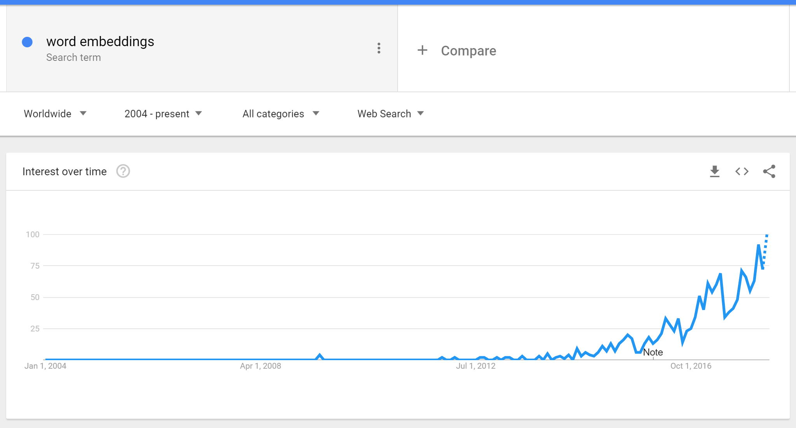
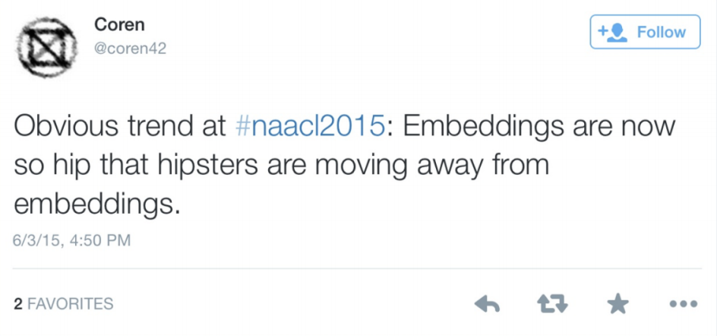
https://trends.google.com/trends/explore?date=all&q=word%20embeddings
Notes:
Word embeddings. Word embeddings are hugely popular as building blocks in neural models for text.

Slide 6

Word2vec is the sriracha sauce of deep learning!
“
Notes:
Chris Manning famously referred to word2vec as the “Sriracha sauce of deep learning”. By popular wisdom, regardless of your neural model or target task, throw in some word embeddings and everything magically gets a little better.

Slide 7
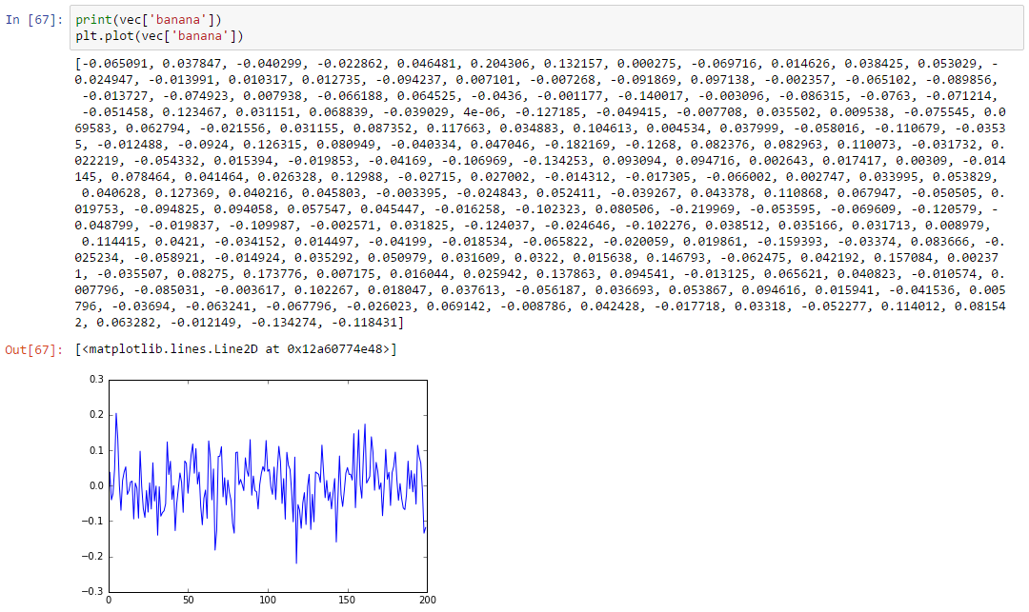
200-dimensional term embedding for “banana”
Notes:
But here’s the problem, word embeddings are also famously opaque. If we look at a 200 dimensional word2vec representation for the term banana, it’s hard to guess the properties of the fruit that have been captured by these numbers.

Slide 8
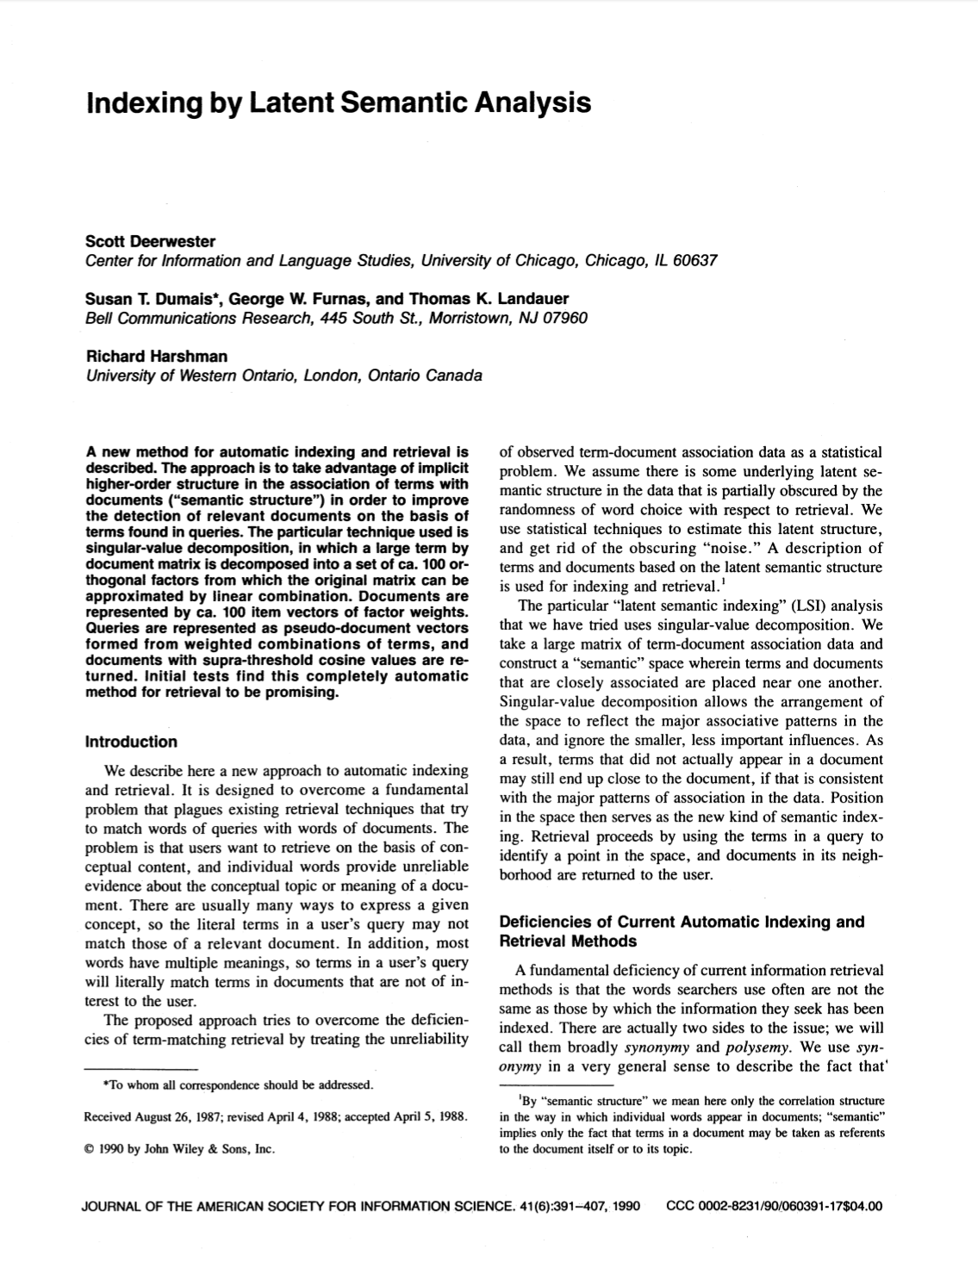
IR has a long history of learning latent representations of terms
Deerwester, Dumais, Furnas, Landauer, and Harshman. Indexing by latent semantic analysis. 1990.
Notes:
Of course, the history of learning short and dense vector representations for terms goes far beyond the recent wave of neural embedding models. The paper on Latent Semantic Analysis—or LSA—for example was written almost 30 years ago.
In that time, many different approaches have been proposed for learning vector representations of text. An obvious question that arises is how these different embedding models—for example, LSA, word2vec, or GloVe—compare to each to other? And I don’t mean just in terms of their performance on an arbitrary set of NLP or IR tasks—which, by the way, may also be influenced significantly by a variety of hyper-parameter choices and other externalities such as the amount of available training data—but in terms of the relationships between items that these models inherently capture. What framework do we have at our disposal that we can use to build intuitions about these dense vector spaces?

Slide 9
An embedding is a representation of items in a new space such that the properties of—and the relationships between—the items are preserved from the original representation
Notes:
Let’s pause and remind ourselves what an “embedding” exactly is.
An embedding is a mapping from one vector space to another such that the relationships between the items are preserved across these two different spaces.

Slide 10
observed space
→
latent space
Notes:
This definition is important because it reminds us that to learn an embedding—may it be word2vec, GloVe, or LSA—we start by representing the items using some observable features. Then we learn a compressed representation of these items such that they mirror similar relationships as in the original feature space.

Slide 11
T: vocabulary, C: set of contexts, S: sparse matrix |T| x |C|
S_{ij} = freq(t_{i},c_{j})
 | C₀ | c₁ | c₂ | … | c_{j} | … | c_{|C|}
t₀
t₁
t₂
…
t_{i} |  |  |  |  | S_{ij}
…
t_{|T|}
Notes:
Here’s a term-context matrix. The context here may refer to the documents in which these terms occur, or the neighboring terms within a window, or we may have some other definition of context. The number of distinct context is typically large. So, in practice this matrix is high dimensional and sparse. Each context (or column) corresponds to a dimension in this high dimensional vector space.

Slide 12
observed feature space
X_{ij} = normalized(S_{ij})
 | C₀ | c₁ | c₂ | … | c_{j} | … | c_{|C|}
t₀
t₁
t₂
…
t_{i} |  |  |  |  | X_{ij}
…
t_{|T|}
Notes:
Each row of counts—raw or normalized—in turn is a vector representation of the corresponding term. This is our observed feature space.

Slide 13
To learn a latent feature space…
Factorize matrix S
(e.g., Latent Semantic Analysis)
 | C₀ | c₁ | c₂ | … | c_{j} | … | c_{|C|}
t₀
t₁
t₂
…
t_{i} |  |  |  |  | S_{ij}
…
t_{|T|}
Notes:
To learn term embeddings, LSA tells us to factorize this matrix.

Slide 14
To learn a latent feature space…
learn a neural embedding of t_{i} by trying to predict c_{j}
(e.g., word2vec)
 | C₀ | c₁ | c₂ | … | c_{j} | … | c_{|C|}
t₀
t₁
t₂
…
t_{i} |  |  |  |  | S_{ij}
…
t_{|T|}
Notes:
On the other hand, for word2vec you would learn the embeddings by trying to predict the context given the term (or vice versa).

Slide 15
To learn a latent feature space…
learn a neural embedding of t_{i} by trying to predict c_{j}
(e.g., word2vec)
W_{in}
W_{out}
t_{i}
c_{j}
Notes:
For example, this is what the neural model would look like in case of word2vec.

Slide 16

The context decides what relationship is modeled
The learning algorithm decides how well it is modeled
word2vec
LSA
Embedding vs. Embedding
Notes:
Note that it is the choice of context—whether it is the “parent document” or the “neighboring terms”—that decides what inter-term relationship your embedding space will capture. LSA, for example, was originally proposed to factorize the term-document matrix while word2vec originally predicted neighboring terms. However, you can also train the LSA model on term-term matrix while paragraph2vec already adapts the word2vec algorithm to predict terms given paragraph or document context.
The learning algorithm—for example, matrix factorization vs. neural networks—largely does not influence the relationship being modeled but only how well it is modeled.

Slide 17
observed space
→
latent space
Notes:
So…

Slide 18
observed space
→
latent space
(
)
(
)
very high dimensional
inconvenient to use
but easy to interpret
low dimensional
convenient to use but
hard to interpret
Notes:
While dense embeddings are massively useful, we should not forget the original feature space from which they are learned. Because the sparse feature space is easier to interpret and hence provides an useful framework for understanding the relationships between the terms that we are modeling. Let’s look at some examples.

Slide 19
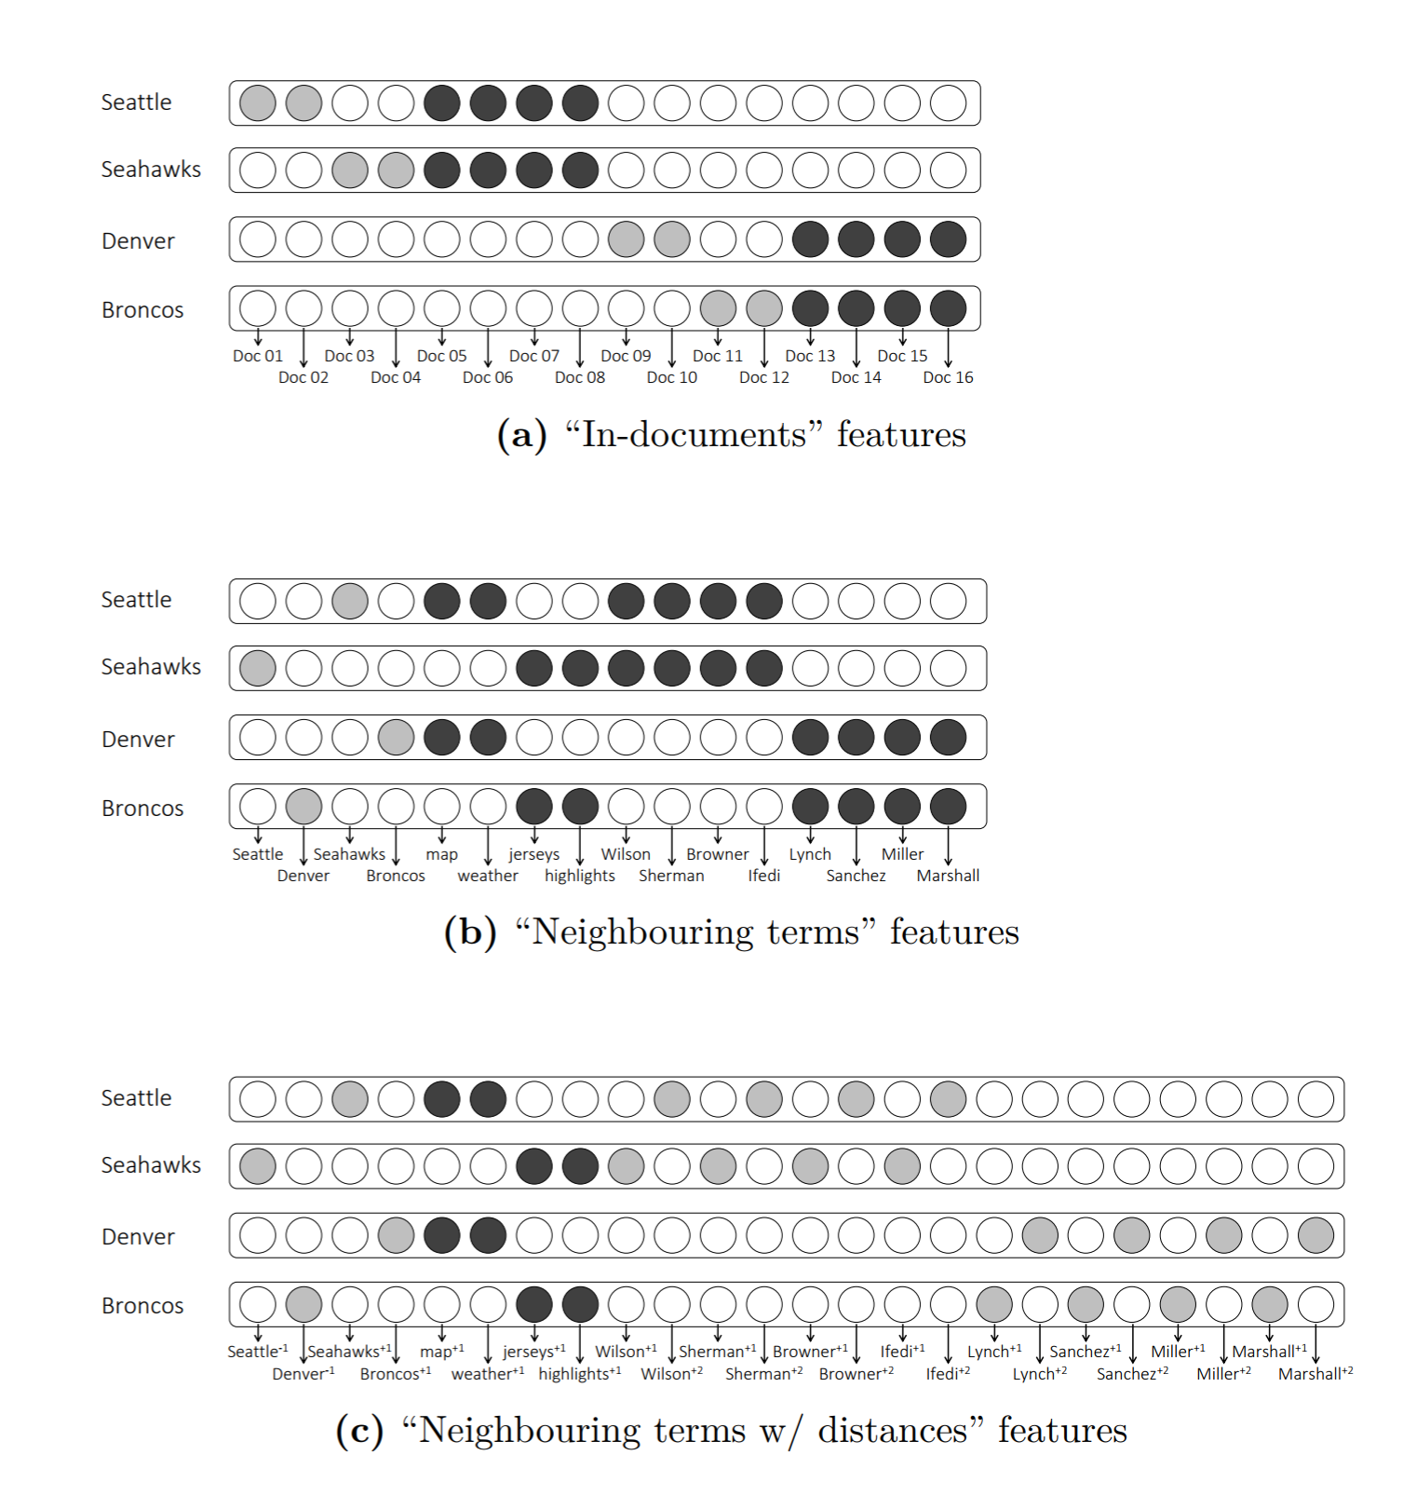
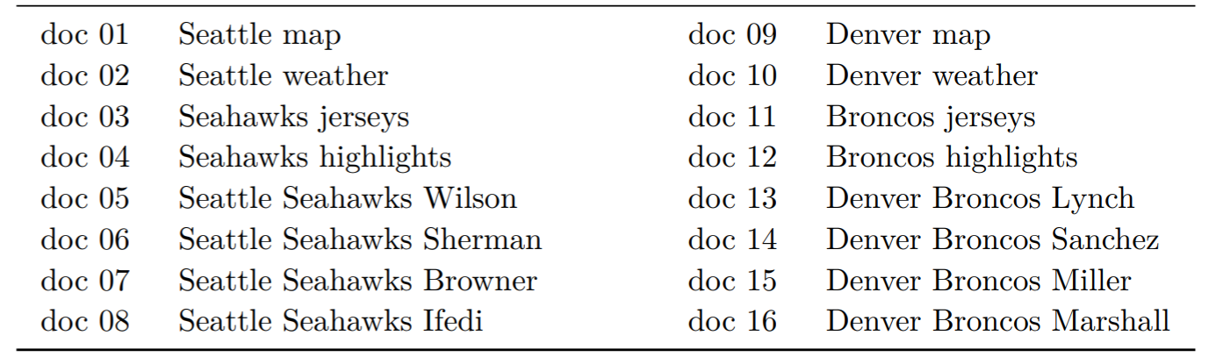
Notions of similarity
Consider the following toy corpus…
Now consider the different vector representations of terms you can derive from this corpus and how the notions of similarity differ in these vector spaces
Notes:
On the left is a toy corpus consisting of 16 short texts. On the right, we have the vector representations for the same four terms—Seattle, Seahawks, Denver, and Broncos—but in three different observed feature spaces.

Slide 20
Notions of similarity
Topical or Syntagmatic similarity
Notes:
If we define our context to be the documents that contains the terms then we end up with a feature representation according to which Seattle is similar to Seahawks, and Denver is closer to Broncos. This is similar to how the original LSA paper defined context.
Note, in this visualization the grey/black circles indicate positive non-zero values. The black circles have no special significance. I am just using black to highlight the dimensions in which more than one term has a positive feature value.

Slide 21
Notions of similarity
Typical or Paradigmatic similarity
Notes:
Next, we define our context based on neighboring terms and the distance between the current and the neighboring term. So for example, Seattle is positive for the feature Wilson^{+2} because Wilson appears two positions to the right from Seattle in document 5. Seahawks on the other hand has a positive value for the feature Wilson^{+1}.
Now if you squint hard enough, you will notice that under this feature definition, Seattle has more overlapping features with Denver, and Seahawks is now closer to Broncos.
The terms that share similar representations in this space are similar by type, while in the previous example the words that are topically similar were closer together.

Slide 22
Notions of similarity
A mix of Topical and Typical similarity
Notes:
Finally, our third feature space is also based on neighboring terms but we ignore the distance between the terms. So, now Seattle shares some common features with Seahawks—such as Wilson and Sherman—while also sharing some common features with Denver—for example, map and weather. This is the definition of context for the popular word2vec model and this crude visualization gives you some intuition about how word2vec embeddings generally capture some mixture of topical and type-based similarities between terms.

Slide 23
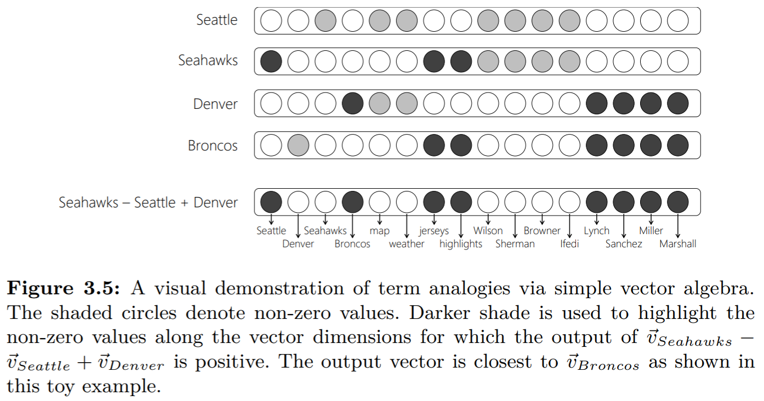
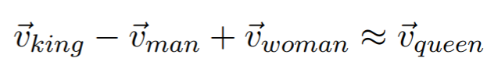
Regularities in observed feature spaces
Some feature spaces capture interesting linguistic regularities
e.g., simple vector algebra in the term-neighboring term space may be useful for word analogy tasks
Levy, Goldberg, and Ramat-Gan. Linguistic Regularities in Sparse and Explicit Word Representations. CoNLL 2014
Notes:
Word2vec is of course famously popular for demonstrating how simple vector algebra over the term embeddings can be useful for word analogy tasks. Here’s the same vector algebra being visualized in the sparse feature space. If you look at the vector for [Seahawks] – [Seattle] + [Denver] and the vector for Broncos then you can see the feature overlaps. While this visualization that I am using here is coarse, I still find it helpful to build some intuitive understanding of how vector algebra in these feature spaces give us somewhat meaningful answers.
Also, it reinforces the point that the regularities that makes such analogies possible exists in the original sparse feature space and isn’t some relationship that the neural model magically inferred.
Check out the paper by Levy et al. for a more detailed discussion on word analogy using observed (or as they call it, explicit) vector spaces.

Slide 24
Why is this important?
Notes:
A clear intuition about the relationship you are modeling in your embedding space is important for practical reasons. For example, if you are going to use pre-trained word embeddings for different IR or NLP tasks, you may want to verify that the notions of similarity captured by your embedding model is aligned to the requirements of your target task.

Slide 25
Document ranking
Query auto-completion
Next query suggestion
cheap flights to london
cheap flights to |
cheap flights to london
✓ budget flights to london
✗ cheap flights to sydney
✗ hotels in london
✓ cheap flights to london
✓ cheap flights to sydney
✗ cheap flights to big ben
✓ budget flights to london
✓ hotels in london
✗ cheap flights to sydney
Notes:
For example, in document ranking if the original search query is about London then you don’t want to present results about Sydney to the user. A text embedding model for this task should therefore not consider Sydney and London to be similar.
On the other hand, for query auto-completion London and Sydney would typically be recommended in the context of the same prefixes. So an embedding model suitable for this task may indeed consider London and Sydney to be similar.
A clear understanding of the relationship you are modeling may also guide you to use pre-trained embeddings in non-obvious ways.

Slide 26
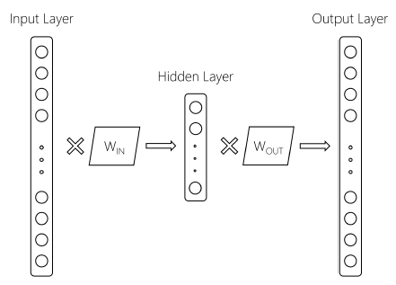
What if I told you that everyone using word2vec is throwing half the model away?
Mitra, Nalisnick, Craswell, and Caruana. A Dual Embedding Space Model for Document Ranking. 2016.
Notes:
For example, people often overlook that there are two separate weight matrices of learnable parameters in the word2vec model corresponding to the embeddings for the input term and the output term. Let’s call them the IN and the OUT embeddings. Typically the OUT embeddings are discarded after training the word2vec model.

Slide 27
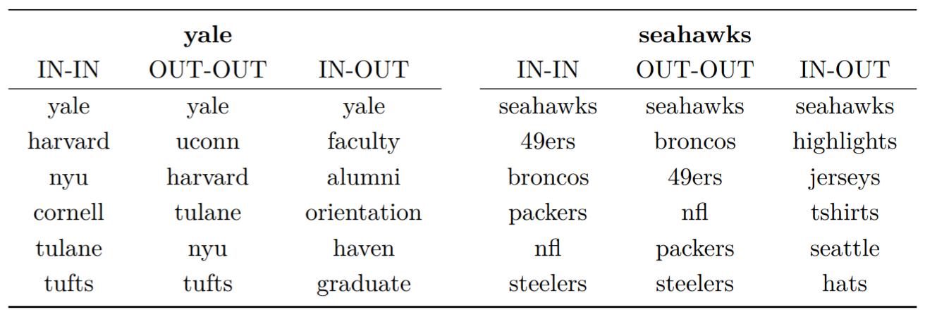
IN-OUT similarity captures a more Topical notion of term-term relationship compared to IN-IN and OUT-OUT
The Duel Embedding Space Model (DESM) proposes to represent query terms using IN embeddings and document terms using OUT embeddings for matching
Mitra, Nalisnick, Craswell, and Caruana. A Dual Embedding Space Model for Document Ranking. 2016.
Notes:
However, the IN-OUT similarity between two terms—i.e., the dot product between the IN embeddings of term 1 and the OUT embeddings of term 2—estimates their co-occurrence probability. This is exactly what the word2vec loss maximizes during training.
This IN-OUT similarity captures a more topical notion of term-term similarity. See how the nearest neighbors of “Yale” using the IN-IN similarity are other universities like Harvard or NYU? But under the IN-OUT similarity, Yale is closer to terms such as “faculty” and “alumni”.
When searching for a document about Yale, a retrieval system may want to rank documents that contain the terms “faculty” or “alumni” higher. You can represent the query terms using the IN embeddings and the document terms using the OUT embeddings and compute the average similarity between the query and document terms. You can use this similarity signal to re-rank the documents for a query.

Slide 28
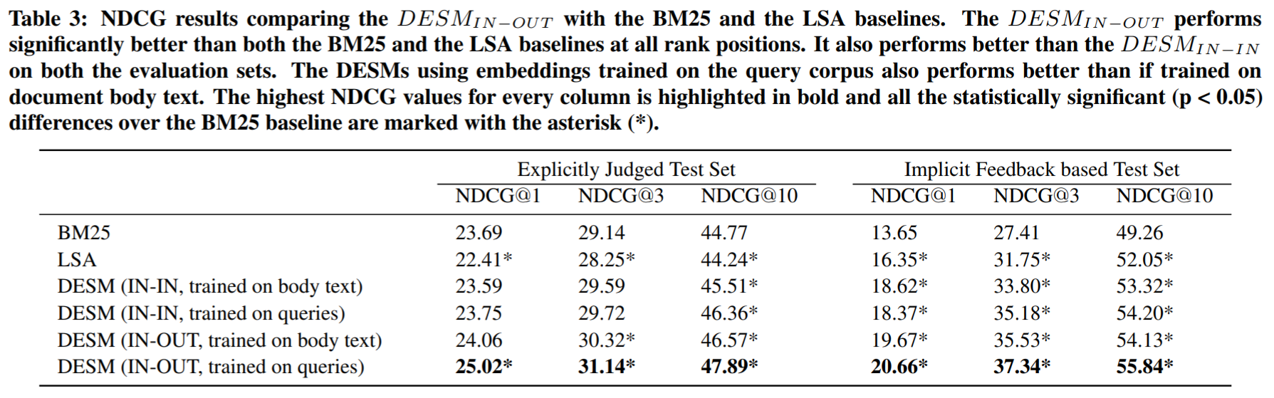
Mitra, Nalisnick, Craswell, and Caruana. A Dual Embedding Space Model for Document Ranking. 2016.
Notes:
Turns out this performs much better compared to using just the IN embeddings for query-document matching.

Slide 29
Get the data
Download
IN+OUT Embeddings for 2.7M words trained on 600M+ Bing queries
https://www.microsoft.com/en-us/download/details.aspx?id=52597
Mitra, Nalisnick, Craswell, and Caruana. A Dual Embedding Space Model for Document Ranking. 2016.
Notes:
In case you are interested, the word embeddings dataset used in this work is available online.

Slide 30
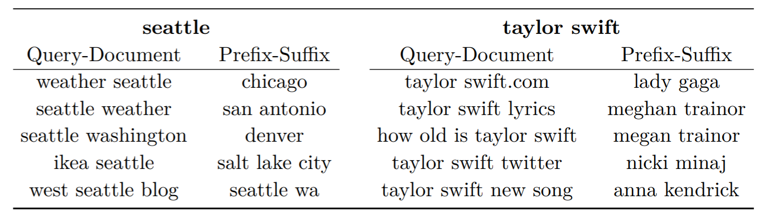
Nearest neighbors for “seattle” and “taylor swift” based on two DSSM models – one trained on query-document pairs and the other trained on query prefix-suffix pairs
Mitra and Craswell. Query Auto-Completion for Rare Prefixes. 2015.
Notes:
This discussion about different notions of similarity isn’t constrained just to word embeddings but for any text embedding models. For example, we see similar parallels with the DSSM model for short text.
By using the DSSM model trained on query-document pairs, we find that the query Seattle is close to other queries about Seattle—for example, Seattle weather or IKEA Seattle—while using the model trained on prefix-suffix pairs the names of other cities are the closest neighbors to Seattle in the embedding space. You can see similar trends with the query Taylor Swift.

Slide 31
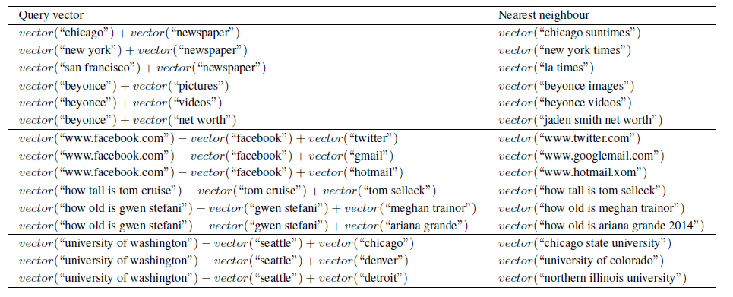
Analogy task using DSSM text embeddings trained on session query pairs
Mitra. Exploring Session Context using Distributed Representations of Queries and Reformulations. 2015.
Notes:
Turns out, you can even do analogy tasks using vector algebra over the DSSM text embeddings if you define the context carefully.

Slide 32
Lessons Learned
#1 | Think sparse, act dense
Notes:
So to summarize, next time you are using word embeddings for your task, do not think of them as a dense black box or sprinkle them over your neural models like magical fairy dust or sriracha sauce. Instead, think carefully about the sparse feature space they approximate and the relationships between items in that space, and the appropriateness of that to your target task.

Slide 33
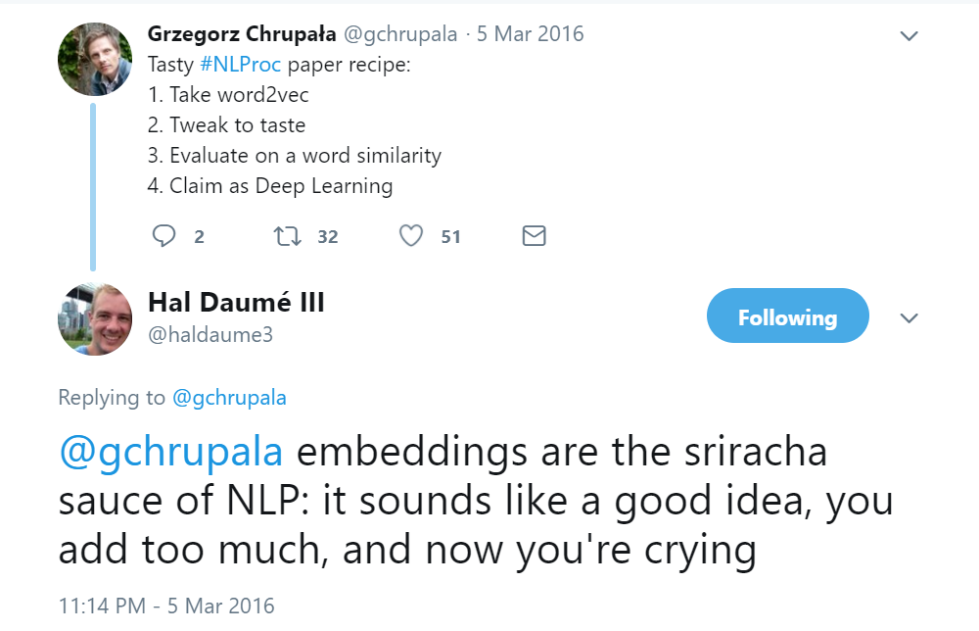
Notes:
By the way, here’s a slightly different take on the Sriracha metaphor for word embeddings…

Slide 34
Lesson #2
The two query problem
Notes:
Lesson #2…

Slide 35
pekarovic land company
what channel seahawks on today
Hard to learn good representations for the rare term “pekarovic”
Easy to estimate relevance based on patterns of exact matches
Solution: match query and document in term space (Salton’s vector space)
Target document likely contains “ESPN” or “Sky Sports” instead of “channel”
An embedding model can associate “ESPN” to “channel” when matching
Solution: match query and document in learned latent (embedding) space
Mitra, Diaz, and Craswell. Learning to Match Using Local and Distributed Representations of Text for Web Search. 2017.
Notes:
Consider these two examples of queries that an IR system needs to handle.
The query on the left contains a rare term “pekarovic”. Traditional term counting based IR systems are actually pretty good at handling such queries. However, a model that learns latent representations will likely struggle because it is unlikely to have good representations for the terms it has never (or rarely) seen during training.
In the case of the query on the right, the relevant document likely doesn’t contain the term “channel” but rather “Sky Sports” or may be “ESPN”. A latent matching model in this case may bear an advantage over an exact matching model because it can learn that “ESPN” and “channel” are related.

Slide 36
A good IR model should consider both matches in the term space as well as matches in the latent space
Notes:
A good IR model should consider both patterns of exact matches of query terms in the document as well as learn good latent representations of query-document text for matching.

Slide 37
E.g., in the DESM paper the embedding based matching follows a lexical candidate generation step (telescoping); or the DESM score can be linearly combined with the lexical model score
Mitra, Nalisnick, Craswell, and Caruana. A Dual Embedding Space Model for Document Ranking. 2016.
Notes:
For example, you can use your latent space model to re-rank the candidates generated by a lexical matching model. Or you can combine your latent space model with a lexical model directly at the same stage. The second approach brings us to…

Slide 38
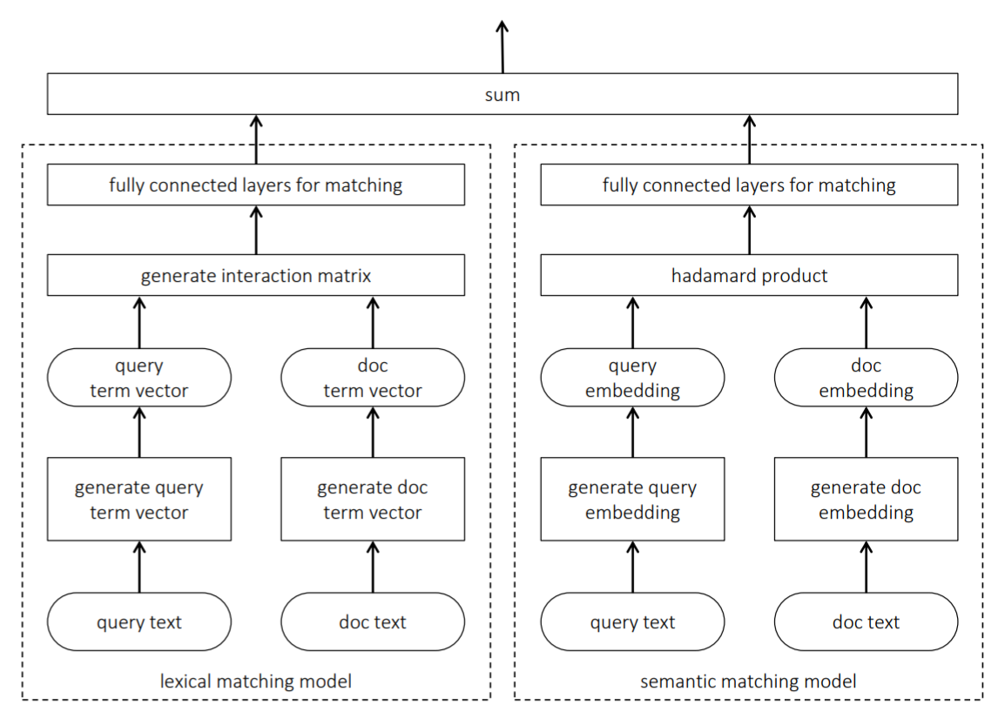
The duet architecture uses deep neural networks to model matching in both term and latent space, and learns their parameters jointly for ranking
Mitra, Diaz, and Craswell. Learning to Match Using Local and Distributed Representations of Text for Web Search. 2017.
Notes:
The duet architecture. The duet architecture proposes to learn two separate sub-models—one that focuses on exact query term matches in the document while the other learns latent representations of query and document text for matching. The two sub-models are jointly trained for the ranking task.

Slide 39
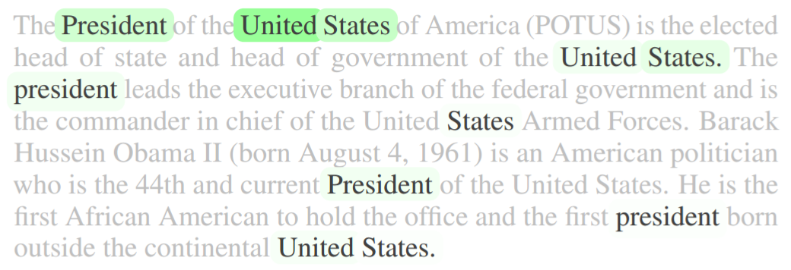
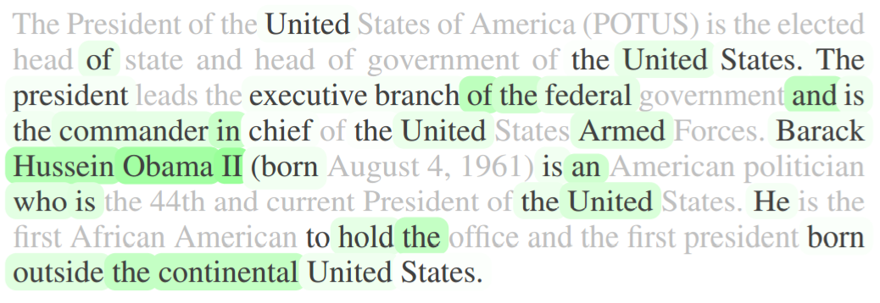
Query: united states president
Matching in term space
Matching in latent space
Mitra, Diaz, and Craswell. Learning to Match Using Local and Distributed Representations of Text for Web Search. 2017.
Notes:
For the query “united states president” here’s a visualization of which terms in a passage the two sub-models focus on. On the left, the exact matching model can only see the occurrences of the query terms in the document. It is blind to all the other terms that may be present. This model may learn that more frequent term matches in the document is a good indication of the document’s relevance to the query, and that matches earlier in the document are more important. On the right, the latent space matching model considers the presence of words such as “Obama” and “federal” as important clues about the document’s relevance to the query “united states president”.

Slide 40
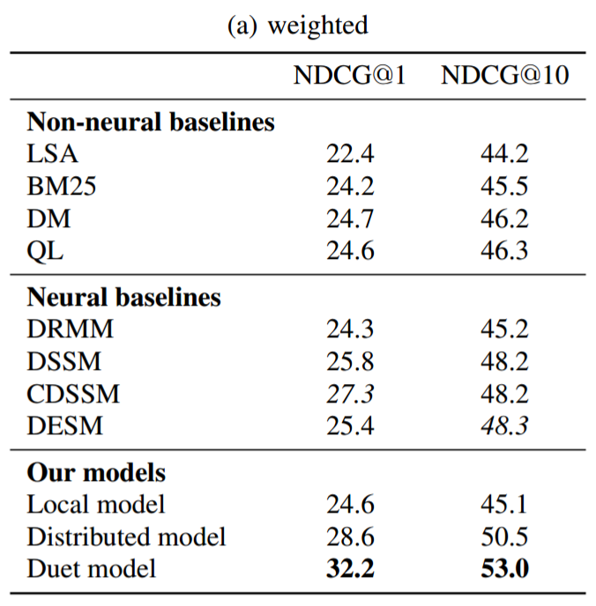
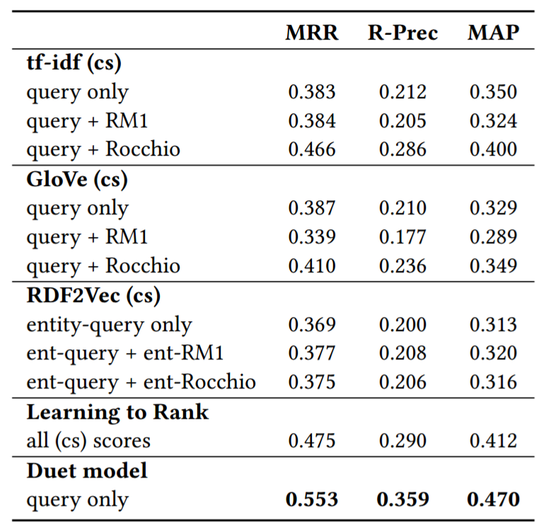
Strong improvements over lexical-only / semantic-only matching models
Document ranking
TREC Complex Answer Retrieval
Mitra, Diaz, and Craswell. Learning to Match Using Local and Distributed Representations of Text for Web Search. 2017.
Notes:
We see pretty significant improvements from the model that combines both lexical and semantic matching over any neural---or traditional---IR model that considers only one of these signals.

Slide 41
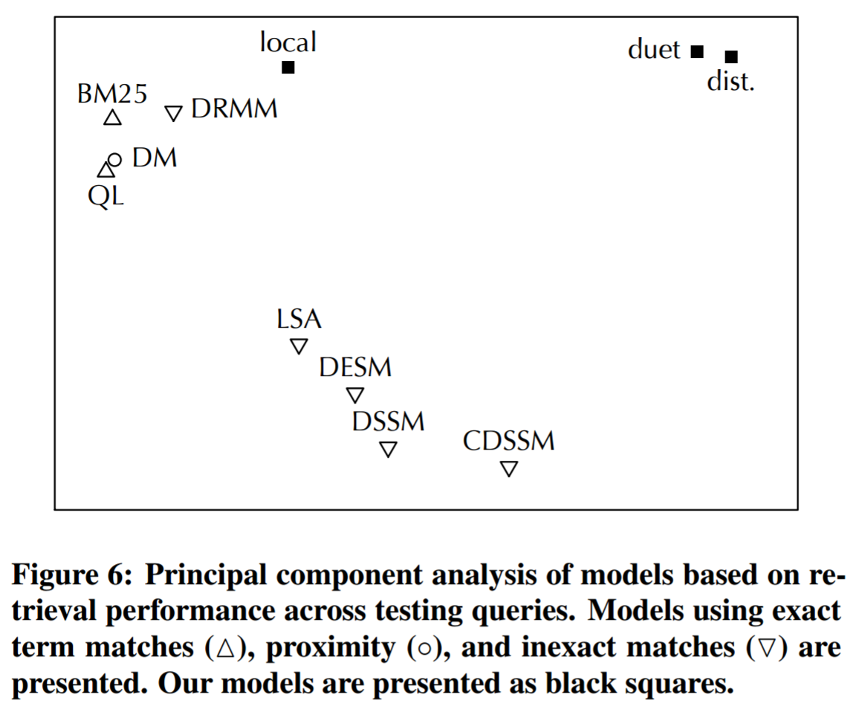
Models that match in the term space perform well on different queries than models that match in the latent space
Mitra, Diaz, and Craswell. Learning to Match Using Local and Distributed Representations of Text for Web Search. 2017.
Notes:
This is a fun plot. I really like this one.
What we did here is take a test set and evaluate each of the models on individual queries in the set. Then we represent each model as a vector of their NDCG performance corresponding to each query in the set. What you see here is the clustering of the models based on what queries they perform well on. As you may notice the models that focus on lexical matching forms a very distinct cluster away from models that match in the latent space.

Slide 42
Lessons Learned
#1 | Think sparse, act dense
#2 | The two query problem
Notes:
Thinking about rare terms and inputs isn’t just important for IR. For example, in machine translation and other NLP tasks you may come up with specific strategies to deal with rare terms—for example, learn when to copy them over exactly from the source sentence, or deal with the fact that these terms do not have well trained embeddings by paying more attention to their neighbors for context, or use special architectures, such as pointer networks, and so on.
The key takeaway message here is to think hard about how your representation learning model generalizes to the two ends of the input spectrum.

Slide 43
Get the code
Download
Implemented using CNTK python API
https://github.com/bmitra-msft/NDRM/blob/master/notebooks/Duet.ipynb
Mitra, Diaz, and Craswell. Learning to Match Using Local and Distributed Representations of Text for Web Search. 2017.
Notes:
If you want to play with the duet code it’s available on GitHub.

Slide 44
The Library or Librarian dilemma
Lesson #3
Notes:
Moving on…

Slide 45
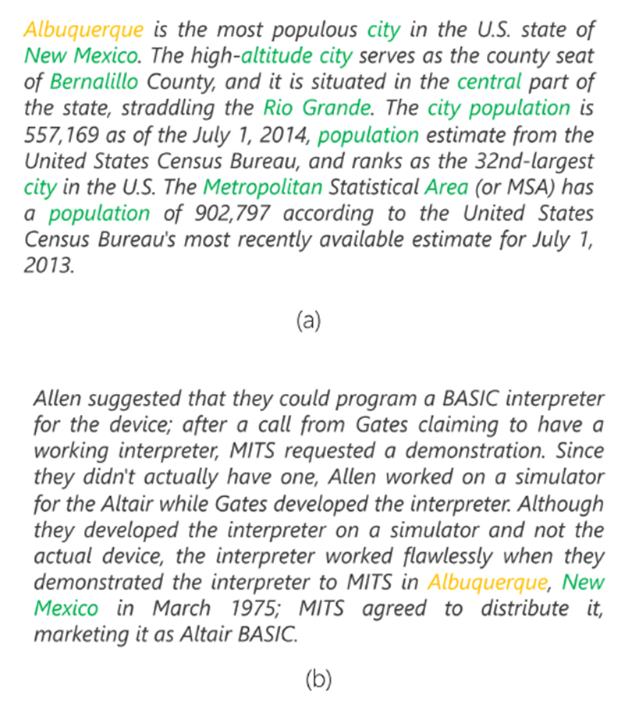
How does a latent space matching model tell these two passages apart?
Passage about Albuquerque
Passage not about Albuquerque
Mitra, Nalisnick, Craswell, and Caruana. A Dual Embedding Space Model for Document Ranking. 2016.
Notes:
Consider the following two passages for the query “Albuquerque”. Both passages have exactly one match for the query term. However, a latent space based matching model can easily figure out that the first passage is about the city because of the presence of other terms such as “population”, “city”, and “area”. The mention of terms such as “simulator” and “device” in the second passage indicates that the passage is not about a city, even though it mentions one.
The latent space model can tell these two passages apart because it learns embeddings or representations which implicitly encode these term-term relatedness. In fact, a crude way to think about these models may be to imagine them as memorizing a very noisy version of term co-occurrences from the “real world”.

Slide 46
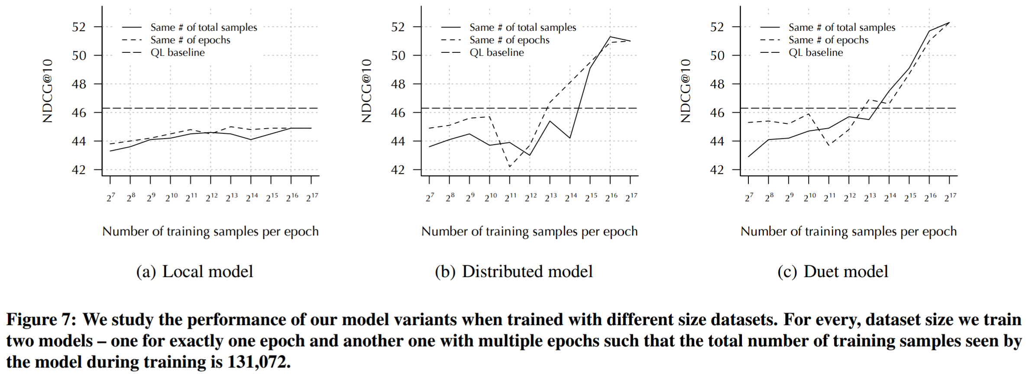
Learning latent representations requires lots more training data
Mitra, Diaz, and Craswell. Learning to Match Using Local and Distributed Representations of Text for Web Search. 2017.
Notes:
When working on the duet model, we noticed that the semantic sub-model requires significantly large amount of training data and keeps improving as it sees more training samples. Effectively, constrained only by some model capacity, the semantic sub-model is “memorizing” certain correlations in the data that may be useful for its relevance estimation task.

Slide 47


or
Notes:
This brings us to an important philosophical question. When designing an IR model should we imagine our model behaving like a library—in that it tries to know “everything about everything”—or should our model behave like a librarian who may have limited information to start with but given the task of finding out information about a narrow topic—say in micro-biology—she may know which section of the library to go look at. Once in that section she may quickly read up some books to better navigate to a particular shelf, repeat the same process again till she finds the correct book, then the chapter, and finally the page where the relevant information is located.
This notion of “learning at query time” is actually pretty popular in IR in the form of pseudo-relevance feedback or PRF. In PRF, a traditional IR model retrieves an initial set of results. The results from this first round of retrieval is used to update the query (e.g., updating the query language model via query expansion), and then a new round of retrieval is executed based on the new information.

Slide 48
Local analysis
vs.
Global analysis
(
)
(
)
E.g., Pseudo Relevance Feedback or PRF
E.g., embeddings trained on a global corpus
Notes:
We generally refer to this as a local (or query-specific) analysis. When we learn a global embedding space for terms and use that for either query-document matching or for query expansion, then we are, in contrast, performing a global—or query-independent—analysis. It is intuitive that a local analysis, while costlier, would hold certain advantages over a global analysis.
But we can also extend the idea of local analysis to learning term embeddings.

Slide 49

query
corpus
cut gasoline tax
Learning query specific latent representations of text for retrieval
results
topic-specific term embeddings
cut gasoline tax deficit budget
expanded query
final results
Diaz, Mitra, and Craswell. Query Expansion with Locally-Trained Word Embeddings. 2016.
Notes:
In a paper couple of years ago, we experimented with the idea of learning a completely new query-specific term embedding space at query-time. As the figure shows, we submit the original query to a retrieval system and retrieve the initial set of document candidates. We then train a word embedding model on this subset of the collection, and use this embedding model to predict good terms for query expansion. The expanded query is then submitted back to the retrieval system and the new set of retrieved documents is finally presented to the user.

Slide 50
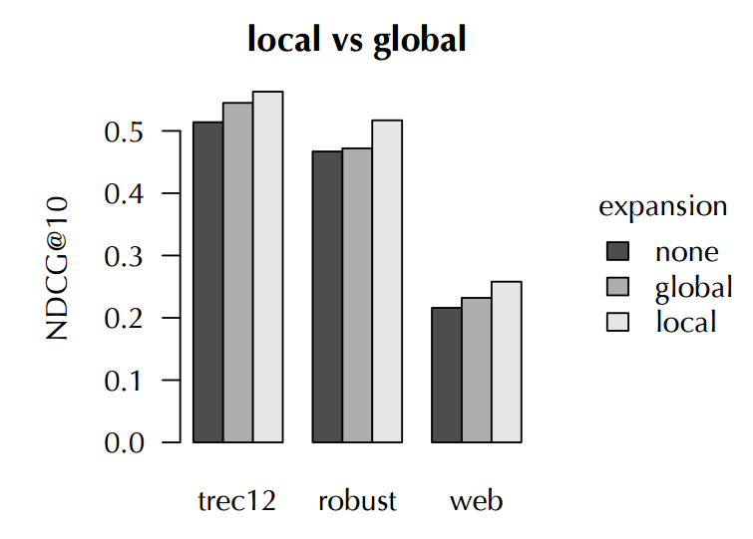
Diaz, Mitra, and Craswell. Query Expansion with Locally-Trained Word Embeddings. 2016.
Notes:
This “locally-trained” or query specific word embedding space proved to be more effective for query expansion in our experiments.

Slide 51
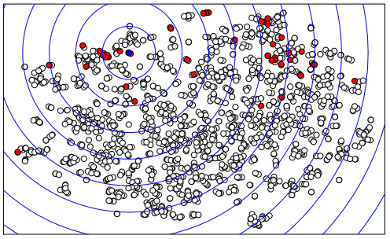
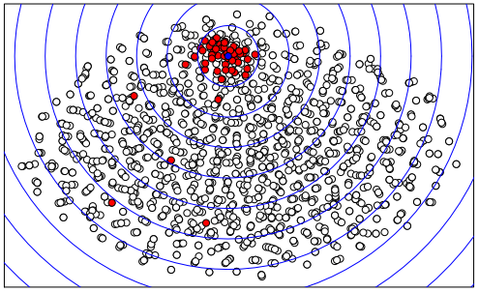
Global embeddings
Local embeddings
Diaz, Mitra, and Craswell. Query Expansion with Locally-Trained Word Embeddings. 2016.
Notes:
Here’s a quick visualization from the paper. At the center, the small blue dot represents the query. All the other dots represent the candidate terms for expansion. The red dots are the good expansion terms while the white dots are the less useful expansion terms. We select expansion terms by searching the neighborhood around the query. Clearly, as you can see, in the local embedding space the good expansion terms are close to the query while in the global embedding space they are scattered all over.
We saw this pattern consistently across multiple queries we inspected.

Slide 52

The mythical tail?
A concept that may be relatively rare may still be referenced by enough number of documents in the collection to derive reliable latent representations from
Notes:
Here’s another way to think about this local vs. global analysis question. When we train a model on a random sample of the full collection the model may never see certain topics. However, these topics may still have enough number of documents for learning reliable representations from if only our model wasn’t trying to learn “everything about everything” but focusing on this single topic.

Slide 53
Lessons Learned
#1 | Think sparse, act dense
#2 | The two query problem
#3 | The Library or Librarian dilemma
Notes:
Local analysis will often give you an advantage over global analysis and I hope we will explore this idea much more in the context of other tasks and models in the future.

Slide 54
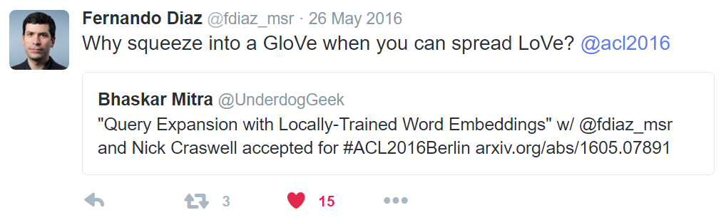
Notes:
Or as my co-author would put it…
In case you are wondering, the pun here is on the GloVe name (as in Global Vectors vs. Local vectors).
I almost convinced Fernando to name the paper LoVe. Almost.

Slide 55
The Clever Hans problem
Lesson #4
Notes:
Lesson #4.

Slide 56
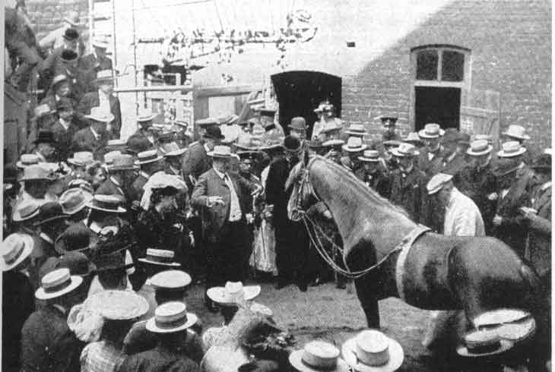
Clever Hans was a horse claimed to have been capable of performing arithmetic and other intellectual tasks.
"If the eighth day of the month comes on a Tuesday, what is the date of the following Friday?“
Hans would answer by tapping his hoof.
In fact, the horse was purported to have been responding directly to involuntary cues in the body language of the human trainer, who had the faculties to solve each problem. The trainer was entirely unaware that he was providing such cues.
(source: Wikipedia)
Notes:
Clever Hans was a horse. It was claimed that he could do simple arithmetic. If you asked Hans a question he would respond by tapping his hoof. After a thorough investigation, it was, however, determined that what Clever Hans was really good at was at reading very subtle and, in fact, unintentional clues that his trainer was giving him via his body language. Hans didn’t know arithmetic at all. But he was very good at spotting body language that CORRELATED highly with the right answer.

Slide 57

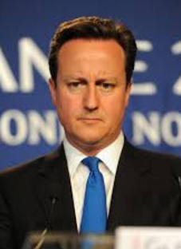
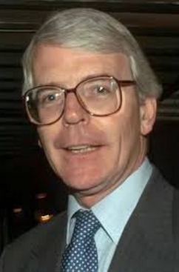
Query: uk prime minister
Today
Recent
In older (1990s) TREC data
Notes:
We have just spoken about how latent matching models “sort of” memorizes term relatedness or co-occurrences from the training data. So if you train such a model on, say, a recent news collection it may learn that the phrase “uk prime minister” is related to Theresa May. Now if you evaluate the same model on older TREC collections where a more meaningful association would have been with John Major, then your model performance may degrade.
This is problematic because what this means is that your model is “overfitting” to the distributions of your training data which may evolve over time or differ across collections. Phrasing it differently, your deep neural model has just very cleverly—like Hans the horse—learnt to depend on interesting correlations that do not generalize and may have ignored the more useful signals for actually modeling relevance.

Slide 58
BM25
What corpus statistics do they depend on?
vs.
Duet
(
)
(
)
Inverse document frequency of terms
Embeddings containing noisy co-occurrence information
Notes:
A traditional IR model, such as BM25, makes very few assumptions about the target collection. You can argue that the inverse document frequencies (and couple of the BM25 hyper-parameters) are all that you would learn from your collection. Which is why you can throw BM25 at most retrieval task (e.g., TREC or Web ranking in Bing) and it would give you pretty reasonable performance in most cases out-of-the-box. On the other hand, take a deep neural model and train it on Bing Web ranking task and then evaluate it on TREC data and I bet it falls flat on its face.

Slide 59
Cross domain performance is an important requirement in many IR scenarios e.g., enterprise search
Notes:
This is an important problem. Think about an enterprise search solution that needs to cater to a large number of tenants. You train your model on only a few tenants—either because of privacy constraints or because most tenants are too small and you don’t have enough training data for the others. But afterwards you need to deploy the same model to all the tenants. Good cross domain performance would be key in such a setting.
How can we make these deep and large machine learning models—with all their lovely bells and whistles—as robust as a simple BM25 baseline?

Slide 60
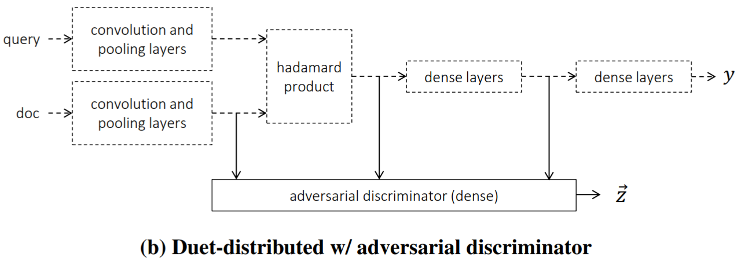
Cohen, Mitra, Hofmann, and Croft. Cross Domain Regularization for Neural Ranking Models using Adversarial Learning. 2018.
Notes:
We’ve recently started doing some work in this space motivated actually by some other recent work in NLP on using adversarial learning for cross domain regularization.

Slide 61
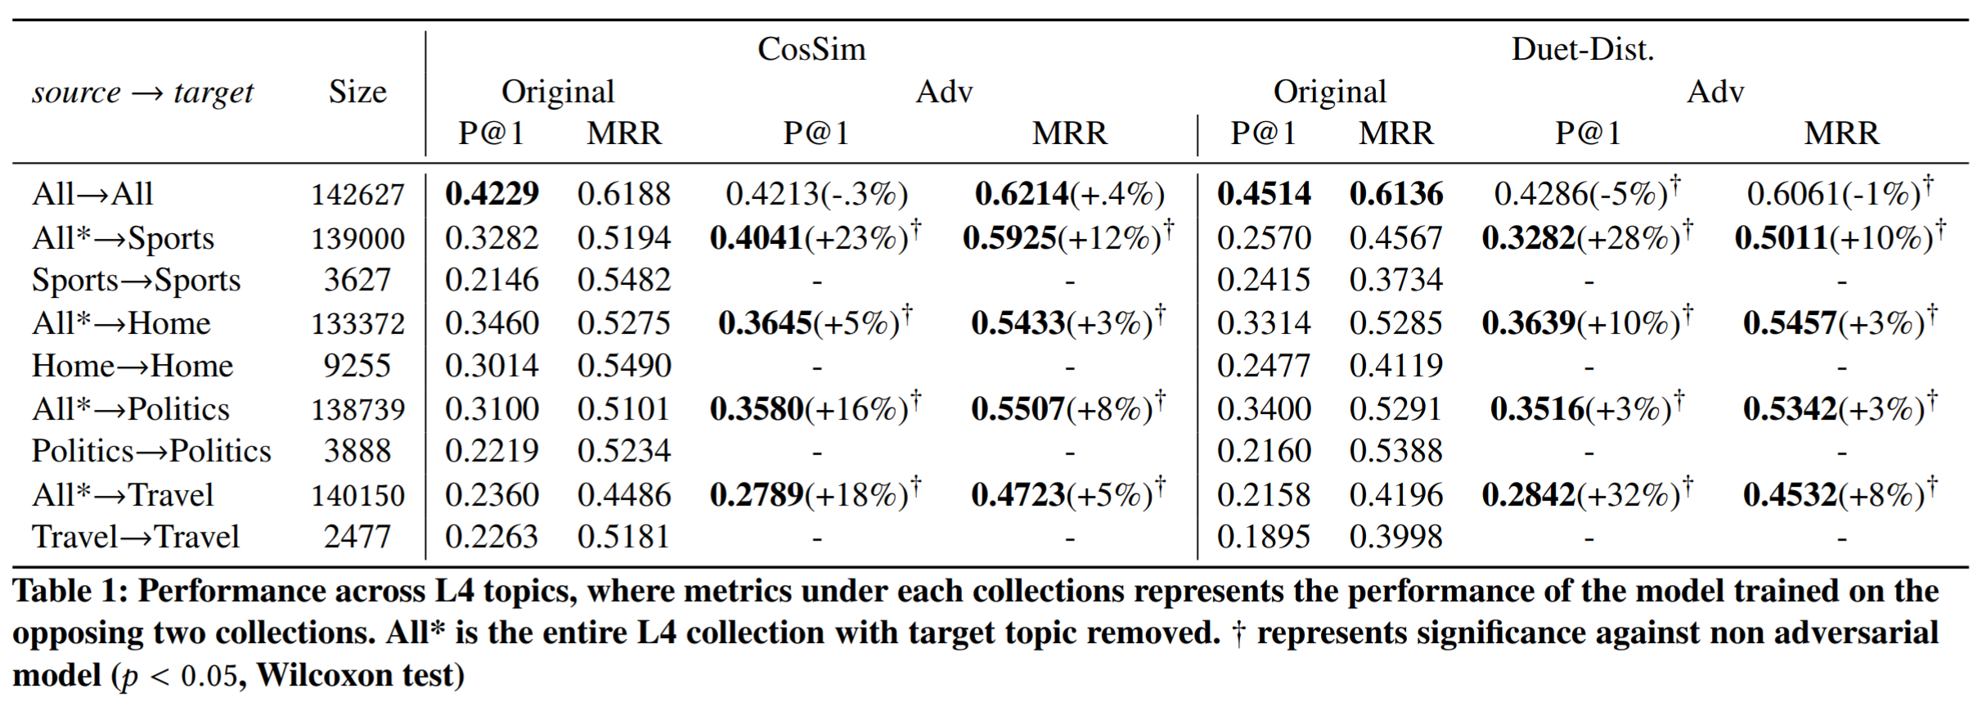
Cohen, Mitra, Hofmann, and Croft. Cross Domain Regularization for Neural Ranking Models using Adversarial Learning. 2018.
Notes:
While we see some improvements, if we are honest they are quite modest compared to the scale of challenges we see in this space. A lot more work is required.

Slide 62
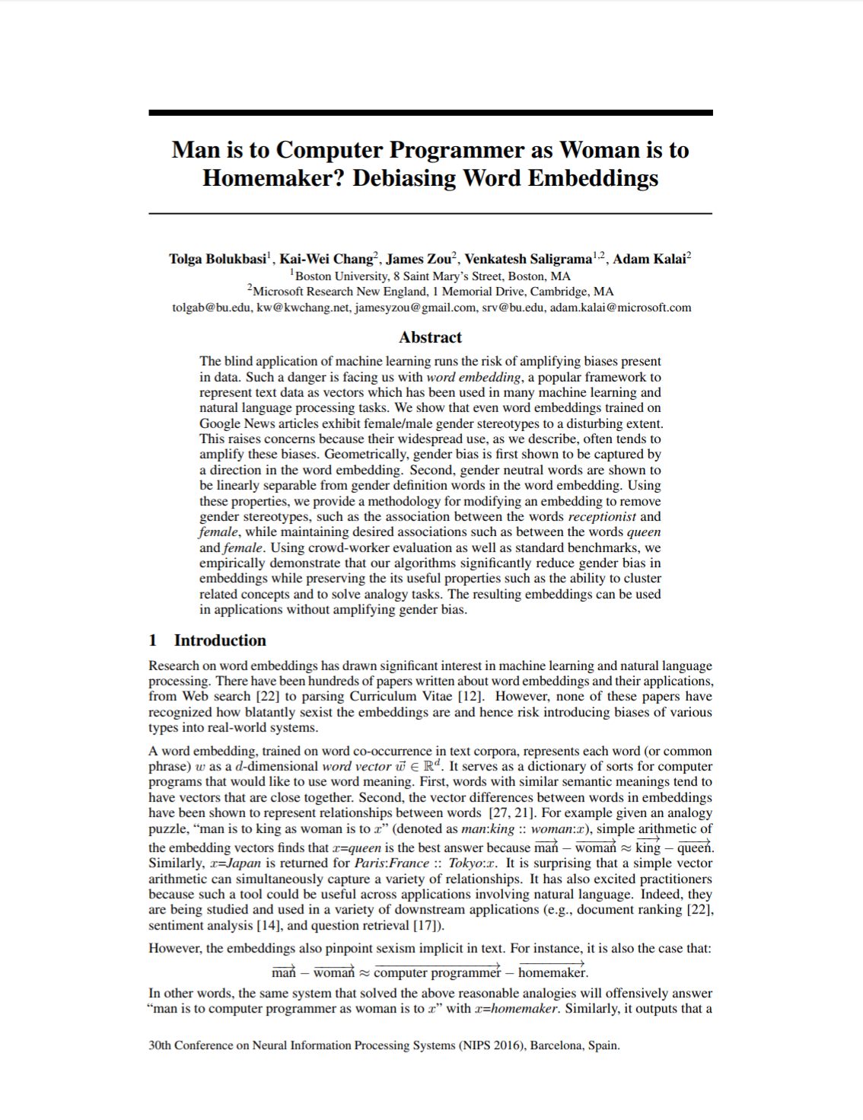
Ethical questions about over dependence on correlations
Bolukbasi, Chang, Zou, Saligrama, and Kalai. Man is to computer programmer as woman is to homemaker? debiasing word embeddings. 2016.
Notes:
But the risk of memorizing correlations isn’t only to inferior performances. It also has many strong ethical implications. Many of the real world collections we train on are naturally biased and encode a lot of our own unfortunate stereotypes. Here’s an interesting paper from some of my colleagues at MSR pointing out how word embeddings may encode gender biases when trained on public collections such as Google News dataset.

Slide 63
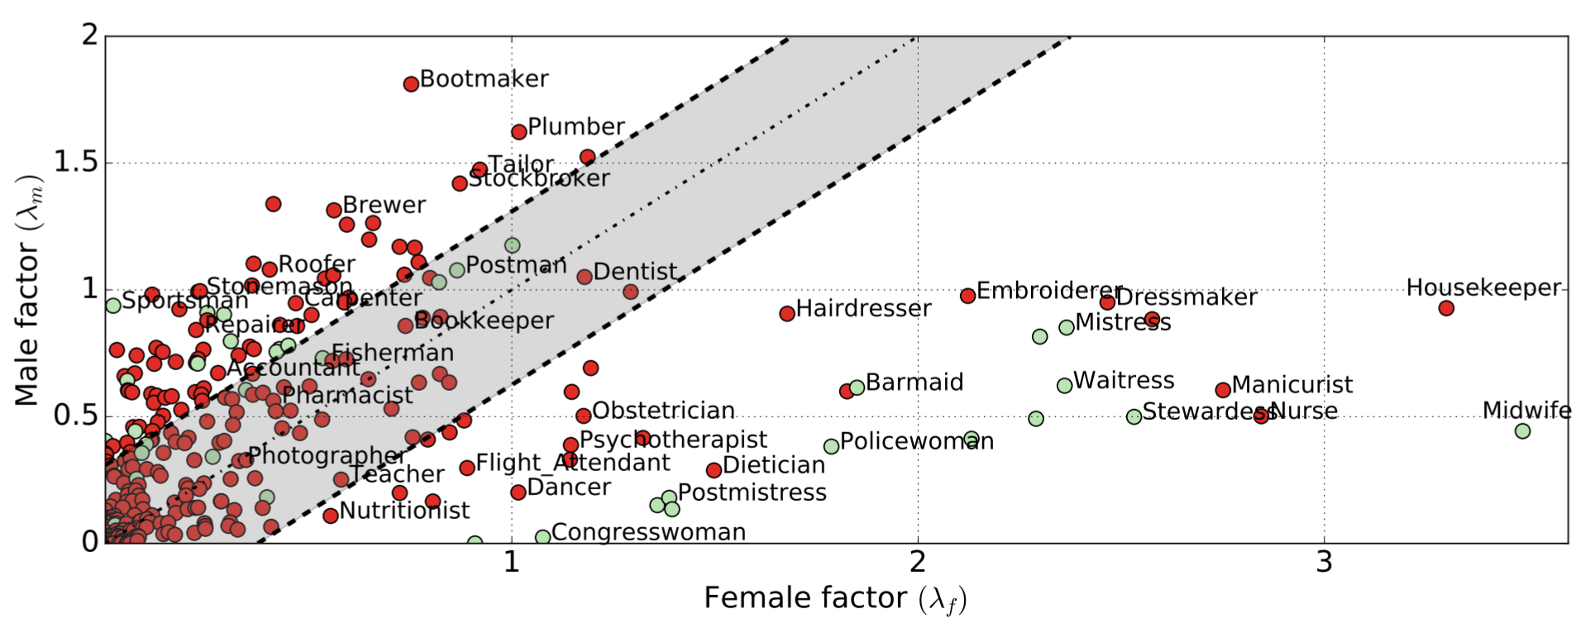
Rekabsaz, Lupu, Hanbury, and Mitra. Explicit Neural Word Representation. 2017.
Notes:
For example, you can see here how certain types of jobs may be unintentionally considered to be more male than female in the learned word embedding space.

Slide 64
Lessons Learned
#1 | Think sparse, act dense
#2 | The two query problem
#3 | The Library or Librarian dilemma
#4 | The Clever Hans problem
Notes:
So be critical of what your model is learning. Some of it may be useful but also brittle that breaks easily when your test distributions change ever so slightly. Or the model may learn patterns that may have unintended and negative consequences.
A whole lot can be said here about interpretability of ML models, causal modeling, and even about model generalization. These are very important research topics that we need to continue making significant progress on.

Slide 65
Hammers and nails
Lesson #5
Notes:
The last message from me for today is one of caution and optimism.

Slide 66
Give a small boy a hammer, and he will find that everything he encounters needs pounding.
“
- Abraham Kaplan
https://en.wikipedia.org/wiki/Law_of_the_instrument
Notes:
We are all familiar with the saying “if all you have is a hammer then everything looks like a nail”.

Slide 67


neural networks
IR
Notes:
Well, in the context of my own research, neural networks is the hammer and IR tasks the nail.

Slide 68
We should be careful not to look too hard for problems that best fits our solution
Notes:
In recent years, neural models have shown breakthrough improvements in many fields and tasks. There’s a lot that the neural IR community can learn from, say, the neural NLP or neural computer vision community. But we should be careful that we do not fall in the trap of getting too excited with what has worked in these other fields and dedicate all our energies to finding suitable IR problems to try them on.

Slide 69
E.g.,
Most neural matching models focus on short text where the vocabulary mismatch problem is more severe
Traditional IR baselines are much stronger when ranking long documents in response to short queries
Harder to show improvements on long text retrieval
Notes:
For example, neural models that learn text embeddings can help with the vocabulary mismatch issue in IR. However, the vocabulary mismatch problem is way more severe when you are matching short text against short text, as opposed to retrieving long text documents in response to short text queries. So not surprisingly people more often evaluate their new and shiny neural models on short text matching tasks where they are more likely to show an improvement over exact term matching techniques.
But retrieving long document text is far from being a solved problem. Many different challenges exist that may require new ways of thinking about these ML models. These are hard challenges but also the ones that are more likely to motivate us to make new breakthroughs in neural models and machine learning in general.
Also, if your model is really trying to address the vocabulary mismatch problem then do not forget to compare with strong IR baselines such as PRF that also focuses on the same issue.

Slide 70
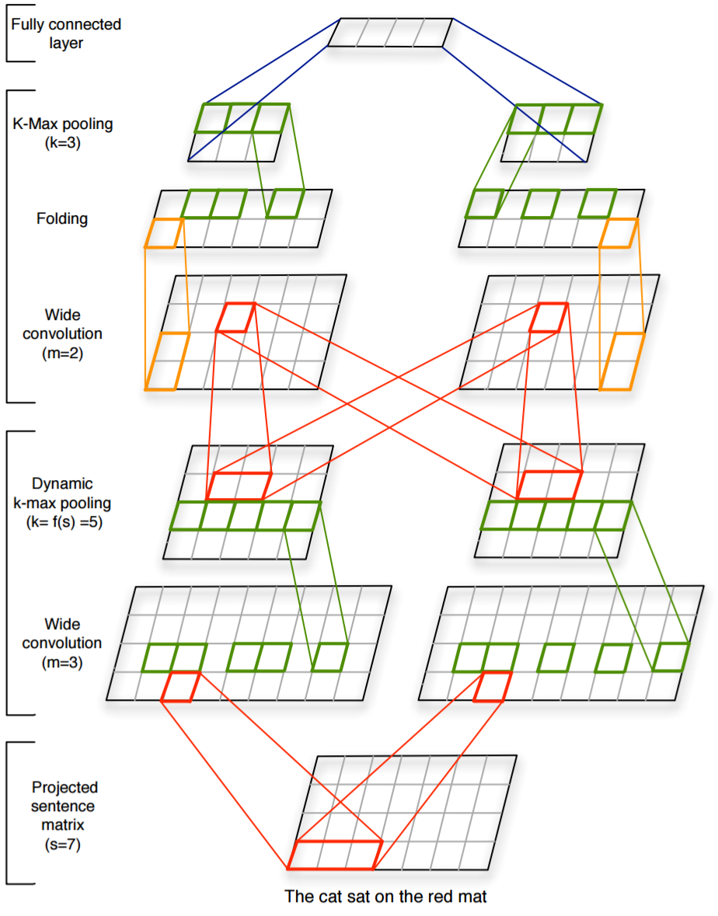
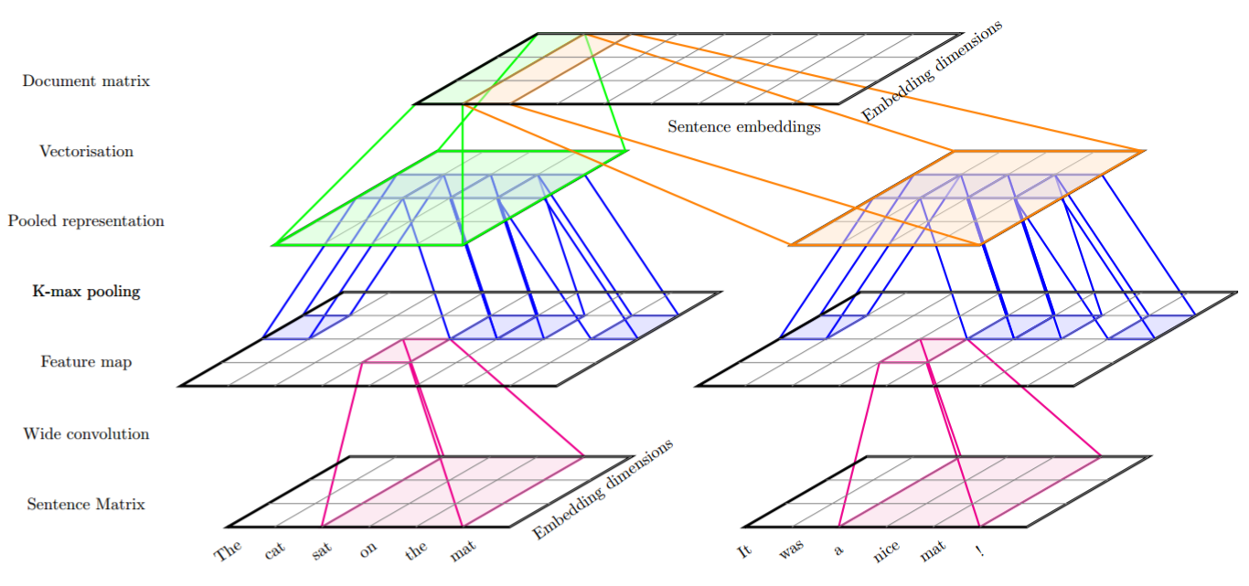
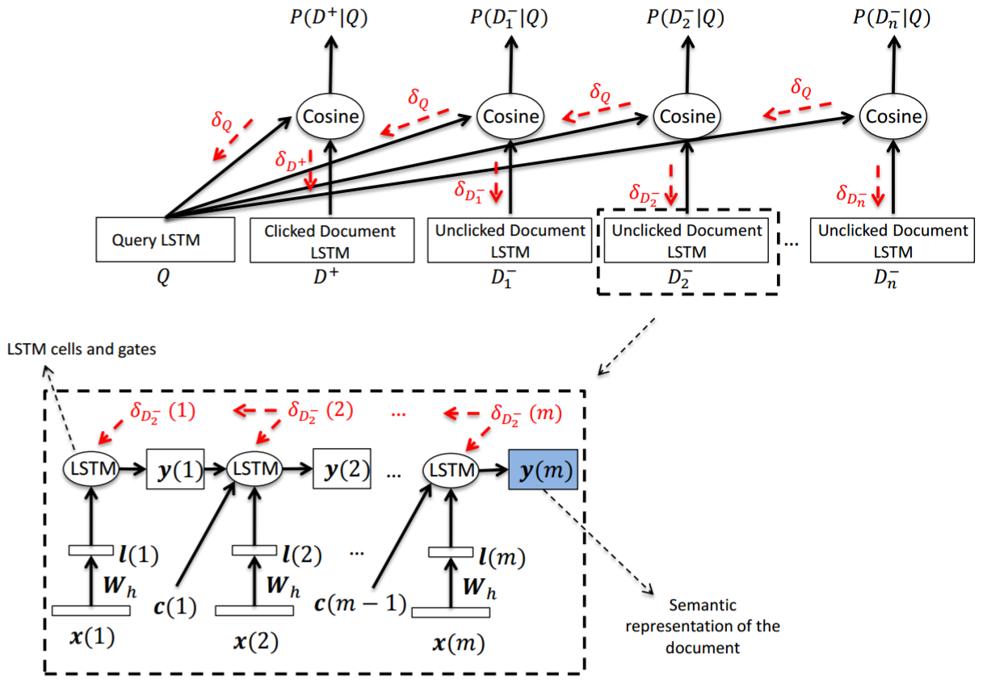
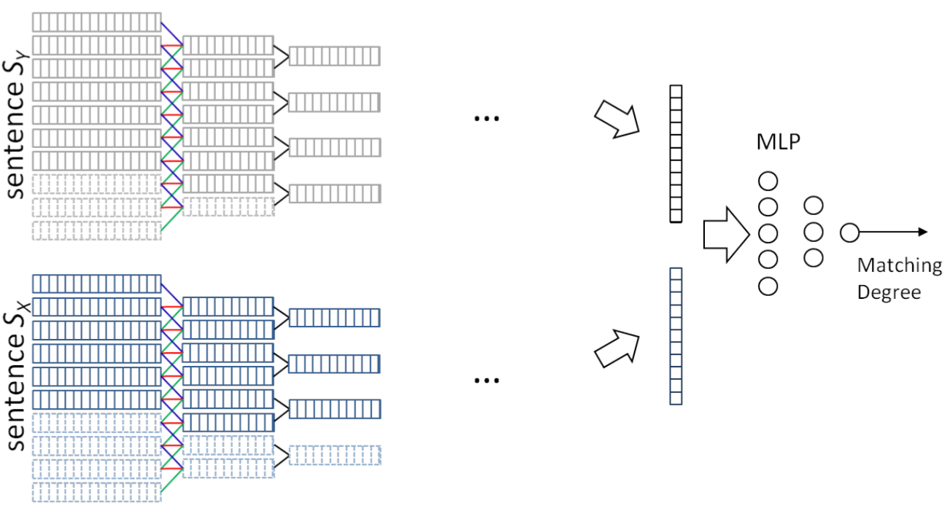
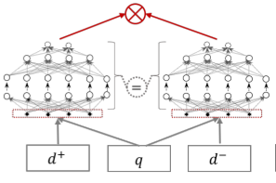
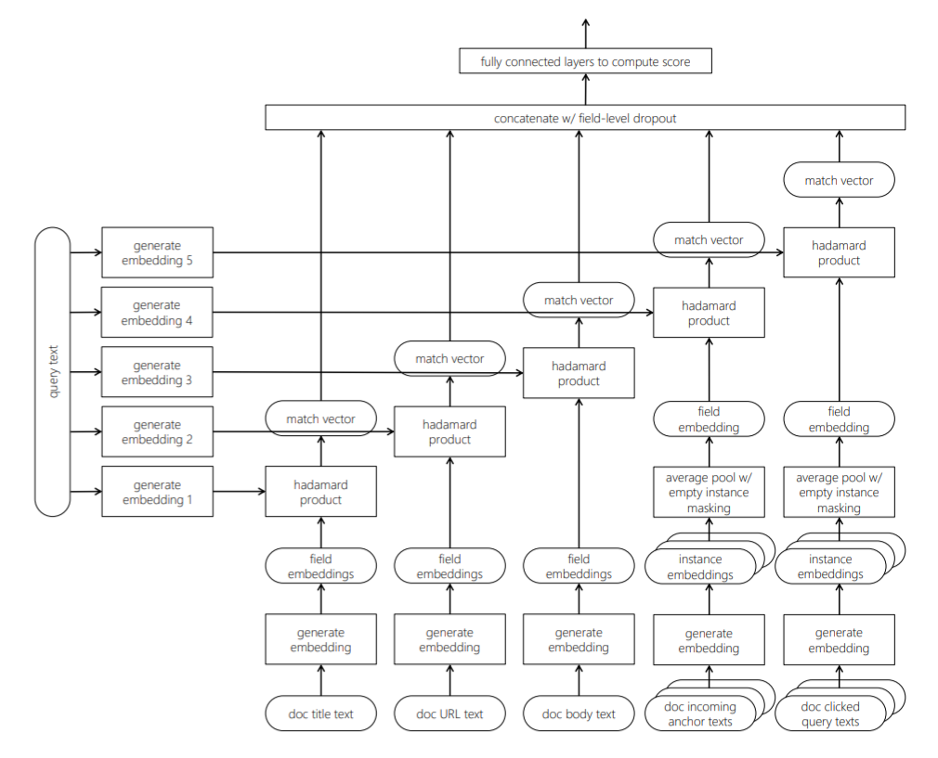
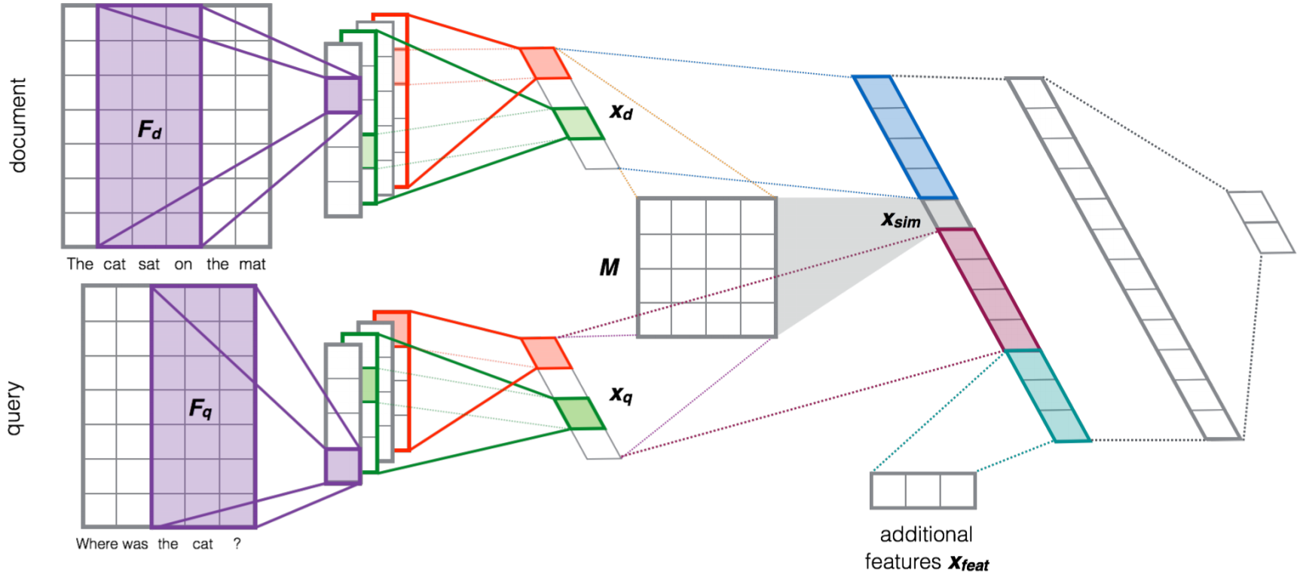
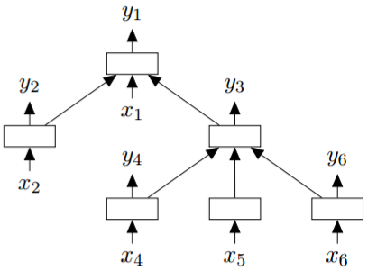
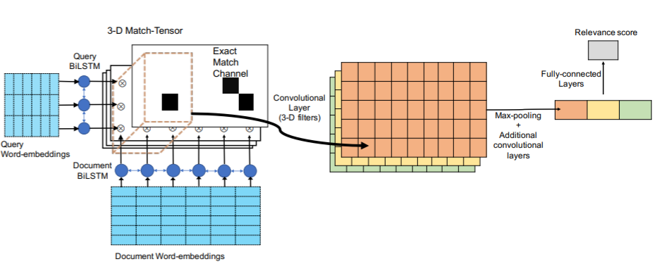
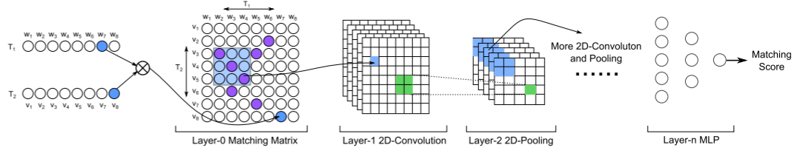
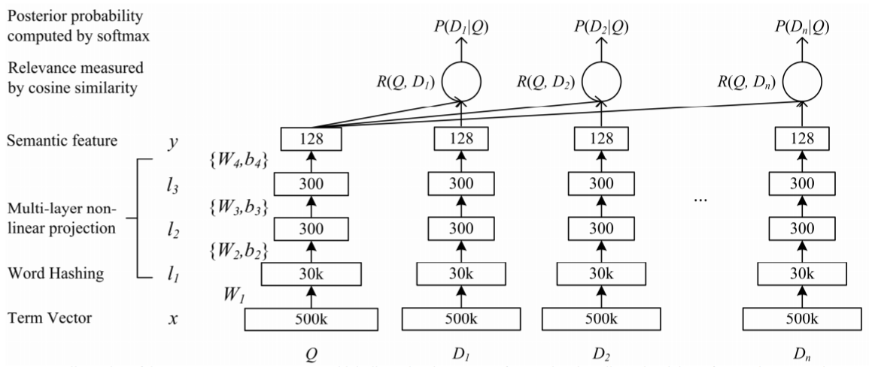
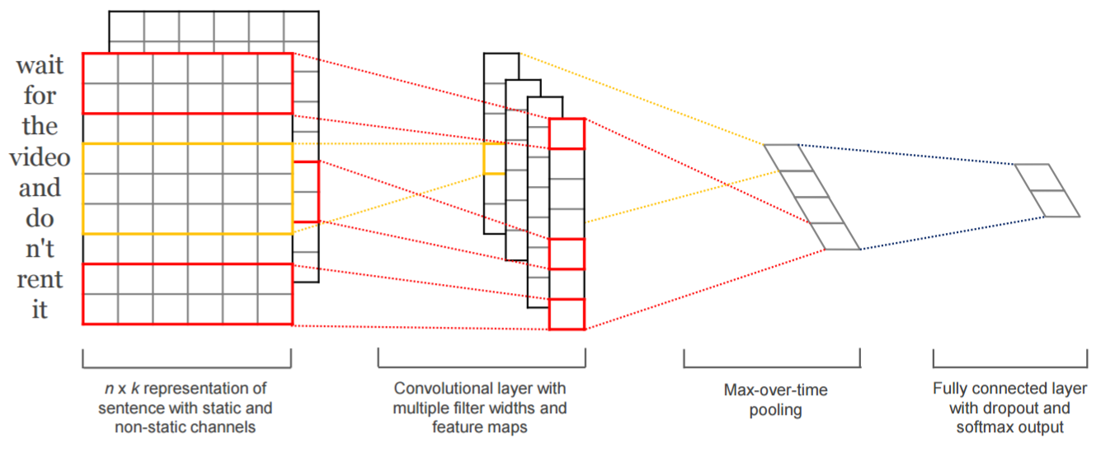
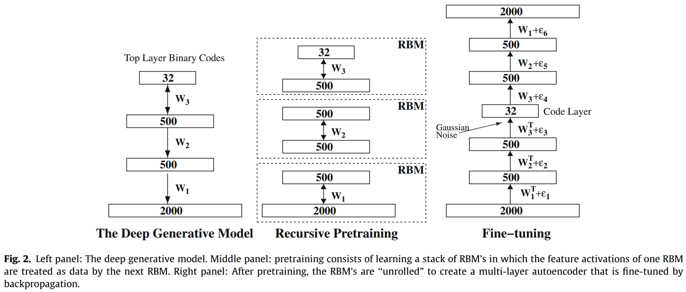
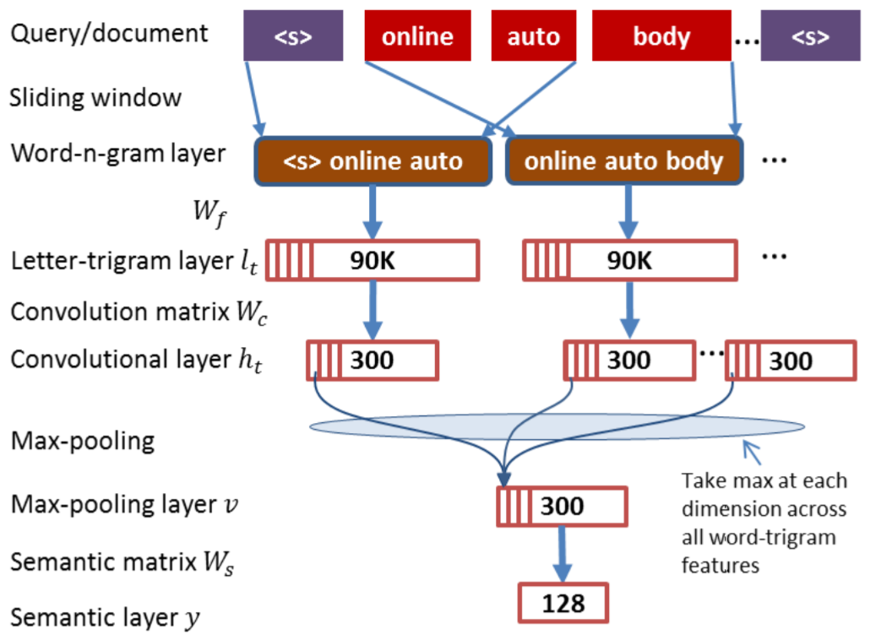
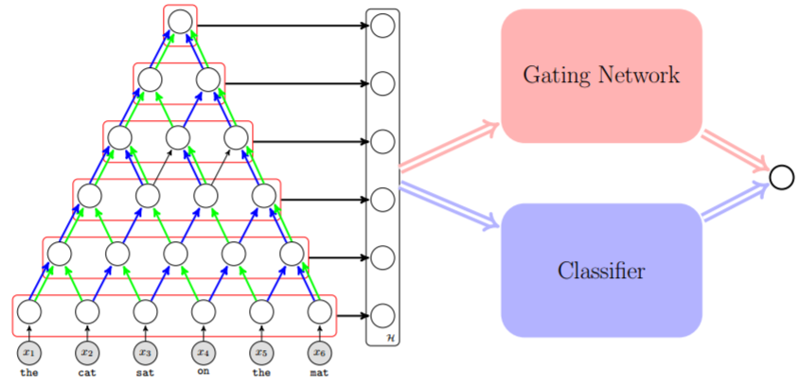
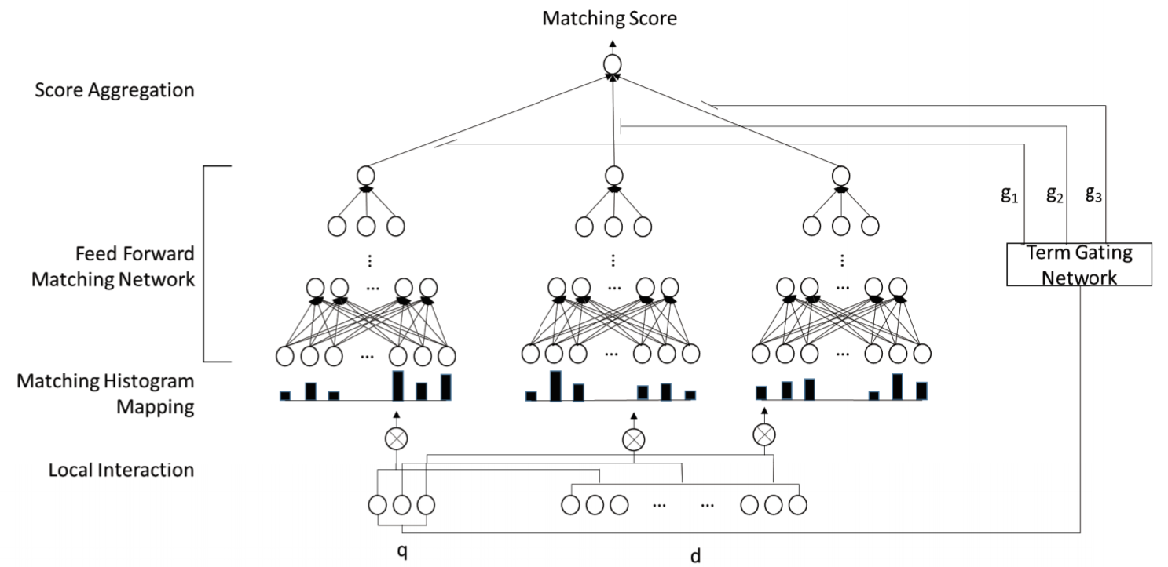
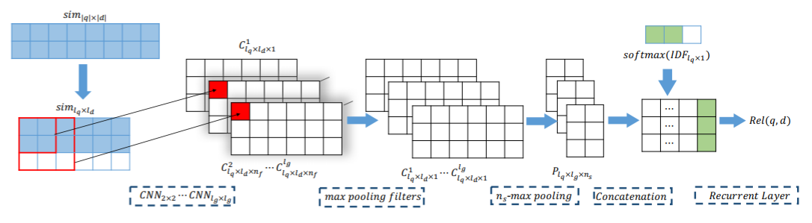
Notes:
We have seen a lot of innovations in text matching models in general in the last few years.

Slide 71
IR ≠ matching
Notes:
But we should also not forget that IR is not just about matching.

Slide 72
IR is about relevance, efficiency, metrics, user modelling, recommendations, structured data, and much more
Neural IR should also encompass all of them
Notes:
It is much much more and neural IR has the opportunity to impact across the board.

Slide 73

E.g., in Bing the candidate generation involves complicated match planning that can be cast as a reinforcement learning task
Rosset, Jose, Ghosh, Mitra, and Tiwary. Optimizing Query Evaluations using Reinforcement Learning for Web Search. 2018.
Notes:
For example, in a large scale IR system such as the Web ranking stack in Bing, generating the candidates for ranking in itself is a very complex challenge that needs to trade-off effectiveness with efficiency. Recently, there has been some very exciting successes in Bing in using reinforcement learning based approaches to dynamic query match planning. These are hard problems where the return on investment from new model innovations is significantly high. So think broadly and creatively when you are thinking about neural approaches to your favorite research domain.

Slide 74
Neural IR → impact + insight
Notes:
Last but not the least, the goal of neural IR should not just be to demonstrate breakthrough performance improvements across a portfolio of IR tasks. But rather these new machine learning models should also grow our fundamental understanding of the field of information retrieval itself.

Slide 75
Lessons Learned
#1 | Think sparse, act dense
#2 | The two query problem
#3 | The Library or Librarian dilemma
#4 | The Clever Hans problem
#5 | Hammers and nails
Notes:
The IR and NLP communities shares many common challenges. At the same time some of the challenges in IR are distinct from NLP, and vice versa. There may be benefits if these communities became more familiar with the challenges and learnings from the other side. The ML, the NLP, and the IR communities have a lot to learn from each other.
So I end this talk on a note of excitement towards all the future cross disciplinary research we may see coming out of these communities and what we may achieve together.

Slide 76


@UnderdogGeek
bmitra@microsoft.com
Notes:
Thank you again for inviting me to present today!

